Slide 1
Pseudo Random and True Random:
Computers work on programs, and programs are definitive set of instructions. So it means there must be some algorithm to generate a random number as well.
If there is a program to generate random number it can be predicted, then it is not true random number.
Random numbers generated through a generation algorithm are called pseudo random.

Slide 2
Can we generate truly random numbers?
In order to generate a truly random number on our computers we need to get the random data from some outside source.
We do not need truly random numbers, unless its related to security.

Slide 3
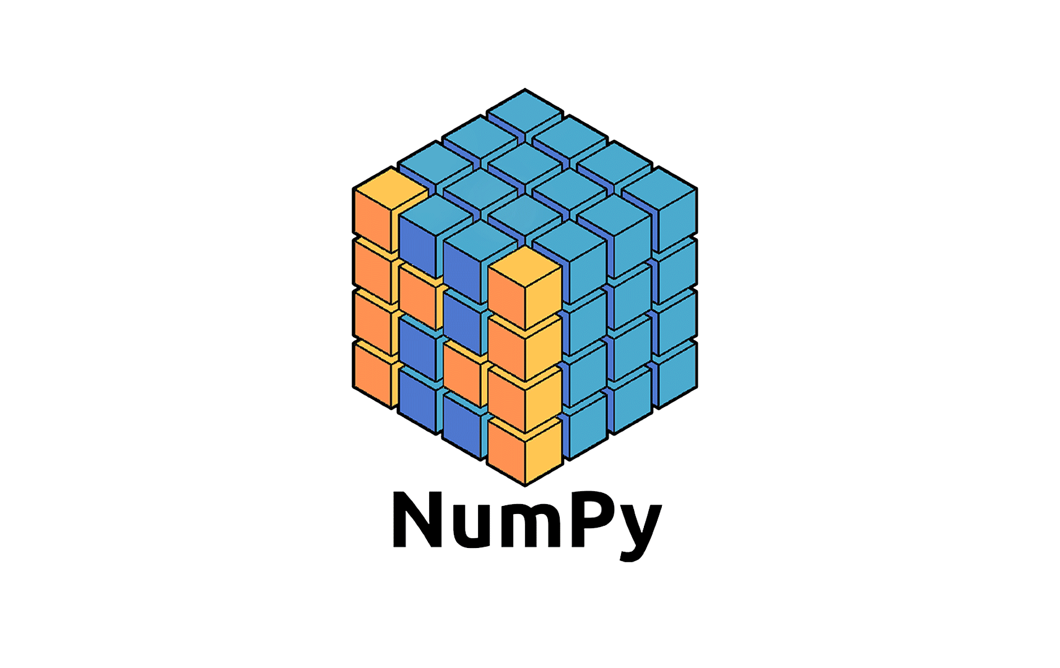
Numpy
Part 21
Arvind Kharwal
www.Kharwal.com

Slide 4
Random Numbers

Slide 5
What is a Random Number?
Random number is a number that can not be predicted logically.

Slide 6
Pseudo Random
True Random:

Slide 7
Can we generate random numbers?
Yes.

Slide 8
Random integer number using random.randint():
Numpy provides the random.randint() function to generate a random integer. The upper bound will not be included.

Slide 9
from numpy import random
x = random.randint(100)
print(x)
74
Generate a 1-D array containing 5 random integers from 0 to 100:
x=random.randint(100, size=5)
print(x)
[12 59 1 85 62]

Slide 10
x = random.randint(1,5,size=10)
print(x)
[3 1 4 3 4 4 4 3 3 4]
x = random.randint(1,5,size=(3,3))
print(x)
[[1 2 1]
[2 4 3]
[2 2 4]]

Slide 11
Random float number using random.rand():
The random.rand() function returns a random float value between 0 and 1.

Slide 12
from numpy import random
x = random.rand()
print(x)
0.4344324309902102
x = random.rand(5)
print(x)
[0.82605422 0.55833013 0.88148843 0.7972482 0.0859434 ]

Slide 13
x = random.rand(3,3)
print(x)
[[0.52115965 0.13657501 0.58617366]
[0.26047314 0.97051541 0.69538283]
[0.27568131 0.18245956 0.38949093]]

Slide 14
The choice() function:
The choice() function allows you to generate a random value based on an array of values. The choice() method takes an array as a parameter and randomly returns one of the values.

Slide 15
Return one of the values in an array:
from numpy import random
x = random.choice([3, 5, 7, 9])
print(x)
3

Slide 16
The choice() method also allows you to return an array of values. We need to add a size parameter to specify the shape of the array.
from numpy import random
d = random.choice([3, 5, 7, 9],size=5)
print(d)
[5 7 3 9 9]

Slide 17
d = random.choice([3, 5, 7, 9],size=(3,4))
print(d)
[[5 5 9 7]
[5 7 7 5]
[3 5 7 9]]

Slide 18
The shuffle() function:
The random.shuffle() function shuffles the sequence.
The input to shuffle() function must be a mutable object.
If we provide an immutable sequence as input (e.g. a string or a tuple), an exception (TypeError) is raised.

Slide 19
list1 = [1,22,3,4,5]
random.shuffle(list1)
print(list1)
[3, 1, 22, 4, 5]

Slide 20
tup1 = (1, 2, 3, 4, 5)
random.shuffle(tup1)
print(tup1)
# TypeError

Slide 21
Thank You

